Slide 1
Path Recommend
----Based On Spark GraphX
team #2

Slide 2
Data Source
Screen Shoots from Line Connector game
Road network of Pennsylvania from Stanford Large Network Dataset Collection

Slide 3









Image Converting

Slide 4
Then we have the matrix to solve this problem easily!
How?
How about the real world stuffs?

Slide 5
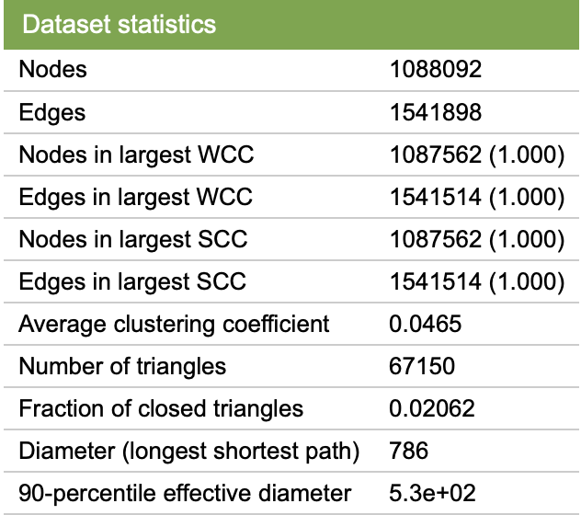
Road network of Pennsylvania
Nodes : the intersections
about 1 million
Roads: the edges
about 1.5 million (for undirected graph)

Slide 6
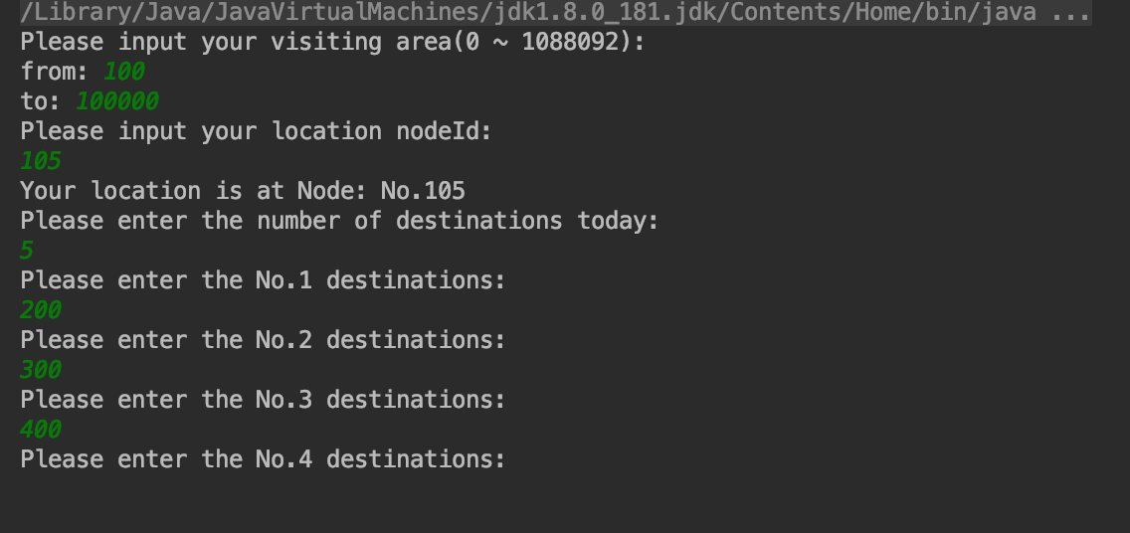
What should users do?
They need to provide their:
1. Visiting area
2. Living node (where they start their journey)
3. Number of the spots they are going to visit
4. Every node they plan to visit

Slide 7
Criteria
For the game:
Our system can evaluate the solution of each game screen shoot in …
The success rate of the game part should be 100%.
For the real world road network:
Our System can provide the path for user in …
The success rate of the game part can be more than 90%, Why?

Slide 8
We use subgraphs
To improve the efficiency, we introduce the subgraph to reduce the dimension of problem. (Because we do not need to traverse all of the nodes apparently)
Improvement:
Sacrifice:

Slide 9
Thank You

